Slide 1
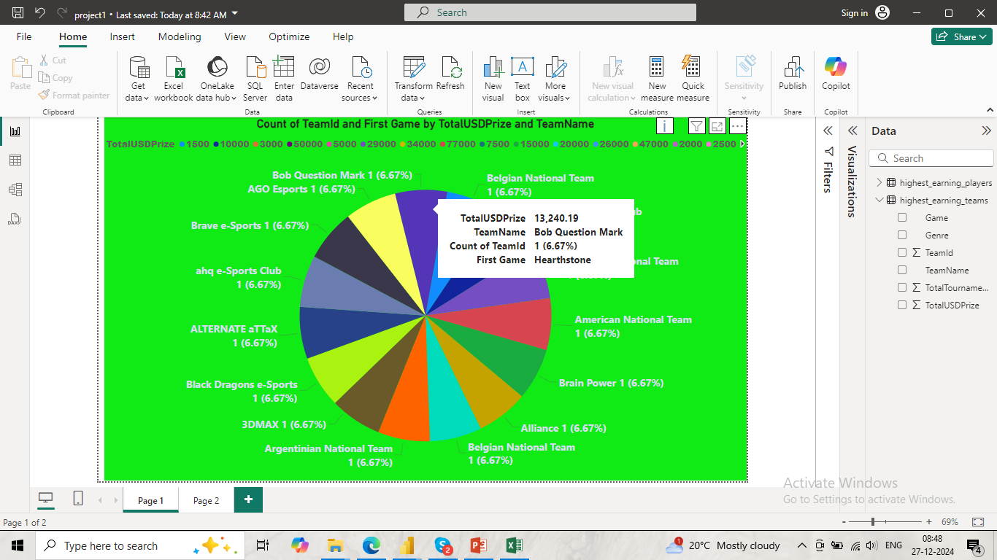

Slide 2
Project name : Highest playing team
Project description:-
The presentation focuses on data analysis for an e-sports competition or gaming tournament, showcasing the distribution of prize amounts and team performances. The main visualization on the current slide is a colorful pie chart representing the count of teams and their first game titles based on their total prize earnings (TotalUSDPrize). Each slice corresponds to a team, labeled with its Team Name, Prize Amount, and First Game..

Slide 3
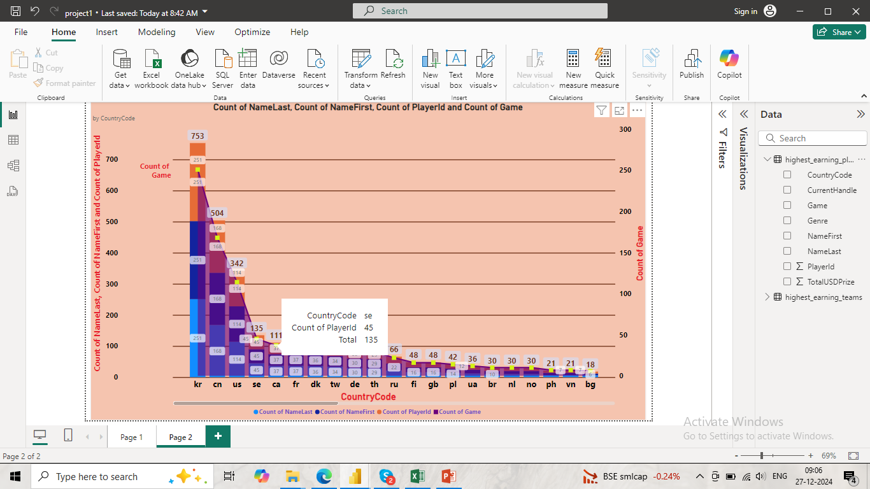

Slide 4
Project name: Highest playing players
Project Description:-
This presentation focuses on data visualization and analysis of player and game statistics by country in the e-sports or gaming domain. The current slide features a stacked bar chart that highlights the distribution of counts for various data points, such as players, games, and associated attributes.

Slide 5
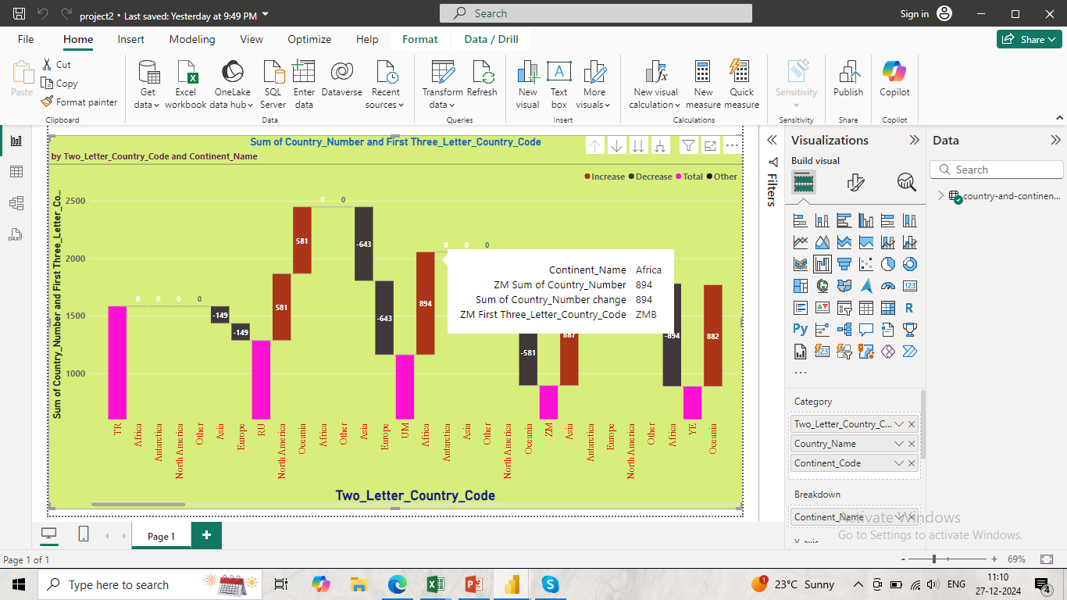

Slide 6
Project name: Country and Continent code
Project Description:-
This project aims to provide detailed reference for country and continent codes, helping easy identification and categorization. It will include continent name , continent code, country name and country numbers widely used in geographic and data systems.

